Slide 1
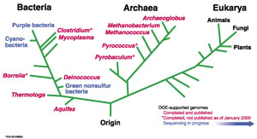
CSE 326: Data Structures
Part Four: Trees
Henry Kautz
Autumn 2002

Slide 2
Material
Weiss Chapter 4:
N-ary trees
Binary Search Trees
AVL Trees
Splay Trees

Slide 3
Other Applications of Trees?
Notes:
File directories or folders on your computer
Moves in a game
Employee hierarchies in organizations and companies
Family trees
Classification hierarchies (e.g. phylum, family, genus, species)

Slide 4
Tree Jargon
Length of a path = number of edges
Depth of a node N = length of path from root to N
Height of node N = length of longest path from N to a leaf
Depth and height of tree = height of root
depth=0, height = 2
A
B
C
D
depth = 2, height=0
E
F

Slide 5
Definition and Tree Trivia
Recursive Definition of a Tree:
A tree is a set of nodes that is
a. an empty set of nodes, or
b. has one node called the root from which zero or more trees (subtrees) descend.
A tree with N nodes always has ___ edges
Two nodes in a tree have at most how many paths between them?

Slide 6
Implementation of Trees
Obvious Pointer-Based Implementation: Node with value and pointers to children
  Problem?
A
B
C
D
E
F

Slide 7
1st Child/Next Sibling Representation
Each node has 2 pointers: one to its first child and one to next sibling
A
A
B
C
D
B
C
D
E
F
E
F

Slide 8
Nested List Implementation 1
Tree := ( label {Tree}* )
a
b
d
c

Slide 9
Nested List Implementation 2
Tree := label || (label {Tree}+ )
a
b
d
c

Slide 10
Application: Arithmetic Expression Trees
Example Arithmetic Expression:
A + (B * (C / D) )
Tree for the above expression:
+
A
*
Used in most compilers
No parenthesis need – use tree structure
Can speed up calculations e.g. replace
/ node with C/D if C and D are known
Calculate by traversing tree (how?)
B
/
C
D

Slide 11
Traversing Trees
+
Preorder: Root, then Children
  + A * B / C D
Postorder: Children, then Root
  A B C D / * +
Inorder: Left child, Root, Right child
  A + B * C / D
A
*
B
/
C
D

Slide 12
Example Code for Recursive Preorder
void print_preorder ( TreeNode T)
{
TreeNode P;
if ( T == NULL ) return;
else { print_element(T.Element);
P = T.FirstChild;
while (P != NULL) {
print_preorder ( P );
P = P.NextSibling; }
}
}
What is the running time for a tree with N nodes?

Slide 13

Binary Trees
Properties
  Notation:
  depth(tree) = MAX {depth(leaf)} = height(root)
  max # of leaves = 2^{depth(tree)}
  max # of nodes = 2^{depth(tree)+1} – 1
  max depth = n-1
  average depth for n nodes =
  (over all possible binary trees)
Representation:
A
B
C
D
E
F
G
H
Data
left
pointer
right
pointer
I
J
Notes:
Alright, we’ll focus today on one type of trees called binary trees.
Here’s one now.
Is this binary tree complete?
Why not?
(C has just one child, right side is much deeper than left)
What’s the maximum # of leaves a binary tree of depth d can have?
What’s the max # of nodes a binary tree of depth d can have?
Minimum?
We won’t go into this, but if you take N nodes and assume all distinct trees of the nodes are equally likely, you get an average depth of SQRT(N).
Is that bigger or smaller than log n?
Bigger, so it’s not good enough!

Slide 14
Dictionary & Search ADTs
Operations
  create
  destroy
  insert
  find
  delete
Dictionary: Stores values associated with user-specified keys
  keys may be any (homogenous) comparable type
  values may be any (homogenous) type
  implementation: data field is a struct with two parts
Search ADT: keys = values
kim chi
  spicy cabbage
kreplach
  tasty stuffed dough
kiwi
  Australian fruit
insert
kohlrabi
- upscale tuber
find(kreplach)
kreplach
- tasty stuffed dough
Notes:
Dictionaries associate some key with a value, just like a real dictionary (where the key is a word and the value is its definition).
In this example, I’ve stored user-IDs associated with descriptions of their coolness level.
This is probably the most valuable and widely used ADT we’ll hit.
I’ll give you an example in a minute that should firmly entrench this concept.

Slide 15
Naïve Implementations
 | unsorted array | sorted array | linked list
insert (w/o duplicates)
find
delete
Goal: fast find like sorted array,
dynamic inserts/deletes like linked list

Slide 16
Naïve Implementations
 | unsorted array | sorted array | linked list
insert (w/o duplicates) | find + O(1) | O(n) | find + O(1)
find | O(n) | O(log n) | O(n)
delete | find + O(1) | O(n) | find + O(1)
Goal: fast find like sorted array,
dynamic inserts/deletes like linked list

Slide 17
Binary Search Tree
Dictionary Data Structure
Search tree property
  all keys in left subtree smaller than root’s key
  all keys in right subtree larger than root’s key
  result:
    easy to find any given key
    inserts/deletes by changing links
8
5
11
2
6
10
12
4
7
9
14
13
Notes:
A binary search tree is a binary tree in which all nodes in the left subtree of a node have lower values than the node. All nodes in the right subtree of a node have higher value than the node.
It’s like making that recursion into the data structure!
I’m storing integers at each node. Does everybody think that’s what I’m _really_ going to store?
What do I need to know about what I store?
(comparison, equality testing)

Slide 18
In Order Listing
visit left subtree
visit node
visit right subtree
10
5
15
2
9
20
7
17
30
In order listing:
Notes:
Anyone notice anything interesting about that in-order listing?
Everything in the left subtree is listed first. Then the root. Then everything in the right subtree.
OK, let’s work out the code to make the in-order listing.
Is there an iterative version that doesn’t use its own stack?
Not really, no. So, recursion is probably OK here. Anyway, if the tree’s too deep for recursion, you must have a huge amount of data.
If (n != null)
inorder(n->left)
cout << n
inorder(n->right)

Slide 19
In Order Listing
visit left subtree
visit node
visit right subtree
10
5
15
2
9
20
7
17
30
In order listing:
2→5→7→9→10→15→17→20→30
Notes:
Anyone notice anything interesting about that in-order listing?
Everything in the left subtree is listed first. Then the root. Then everything in the right subtree.
OK, let’s work out the code to make the in-order listing.
Is there an iterative version that doesn’t use its own stack?
Not really, no. So, recursion is probably OK here. Anyway, if the tree’s too deep for recursion, you must have a huge amount of data.
If (n != null)
inorder(n->left)
cout << n
inorder(n->right)

Slide 20
Finding a Node
Node find(Comparable x, Node root)
{
if (root == NULL)
return root;
else if (x < root.key)
return find(x,root.left);
else if (x > root.key)
return find(x, root.right);
else
return root;
}
10
5
15
2
9
20
7
17
30
runtime:
Notes:
Now, let’s try finding a node.
Find 9.
This time I’ll supply the code.
This should look a _lot_ like binary search!
How long does it take?
Log n is an easy answer, but what if the tree is very lopsided?
So really, this is worst case O(n)!
A better answer is theta of the depth of the node sought.
If we can bound the depth of that node, we can bound the length of time a search takes.
What about the code? All those &s and *s should look pretty scary. Let’s talk through them.

Slide 21
Insert
Concept: proceed down tree as in Find; if new key not found, then insert a new node at last spot traversed
void insert(Comparable x, Node root) {
// Does not work for empty tree – when root is NULL
if (x < root.key){
if (root.left == NULL)
root.left = new Node(x);
else insert( x, root.left ); }
else if (x > root.key){
if (root.right == NULL)
root.right = new Node(x);
else insert( x, root.right ); } }
Notes:
Let’s do some inserts:
insert(8)
insert (11)
insert(31)

Slide 22
Time to Build a Tree
Suppose a₁, a₂, …, a_{n} are inserted into an initially empty BST:
  a₁, a₂, …, a_{n} are in increasing order
  a₁, a₂, …, a_{n} are in decreasing order
  a₁ is the median of all, a₂ is the median of elements less than a₁, a₃ is the median of elements greater than a₁, etc.
  data is randomly ordered
Notes:
OK, we had a buildHeap, let’s buildTree. How long does this take?
Well, IT DEPENDS!
Let’s say we want to build a tree from 123456789
What happens if we insert in order?
Reverse order?
What about 5, then 3, then 7, then 2, then 1, then 6, then 8, then 9?

Slide 23
Analysis of BuildTree
Increasing / Decreasing: θ(n²)
  1 + 2 + 3 + … + n = θ(n²)
Medians – yields perfectly balanced tree
  θ(n log n)
Average case assuming all input sequences are equally likely is θ(n log n)
  equivalently: average depth of a node is log n
  Total time = sum of depths of nodes
Notes:
Average runtime is equal to the average depth of a node in the tree.
We’ll calculate the average depth by finding the sum of all depths in the tree, and dividing by the number of nodes.
What’s the sum of all depths?
D(n) = D(I) + D(N - I - 1) + N - 1
(left subtree = I, root is 1 node, so right = n - I - 1. D(I) is depth of left, 1 node deeper in overall, same goes for right, total of I + N - I - 1 extra depth).
For BSTs, all subtree sizes are equally likely (because we pick the middle element and random and the rest fall on the left or right determinically).
Each subtree then averages 1/N * sum 0 to N-1 of D(j)

Slide 24
Proof that Average Depth of a Node in a BST Constructed from Random Data is θ(log n)
Method: Calculate sum of all depths, divide by number of nodes
D(n) = sum of depths of all nodes in a random BST containing n nodes
D(n) = D(left subtree)+D(right subtree)
+ adjustment for distance from root to subtree
+ depth of root
D(n) = D(left subtree)+D(right subtree)
+ (number of nodes in left and right subtrees)
+ 0
D(n) = D(L)+D(n-L-1)+(n-1)

Slide 25
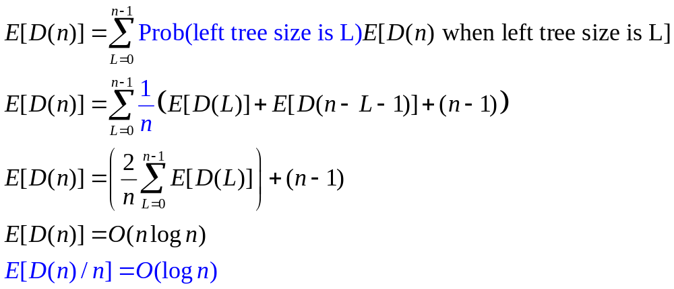
Random BST, cont.
D(n) = D(L)+D(n-L-1)+(n-1)
For random data, all subtree sizes equally likely
this looks just like the Quicksort average case equation!

Slide 26
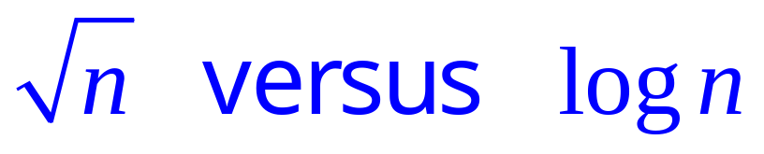
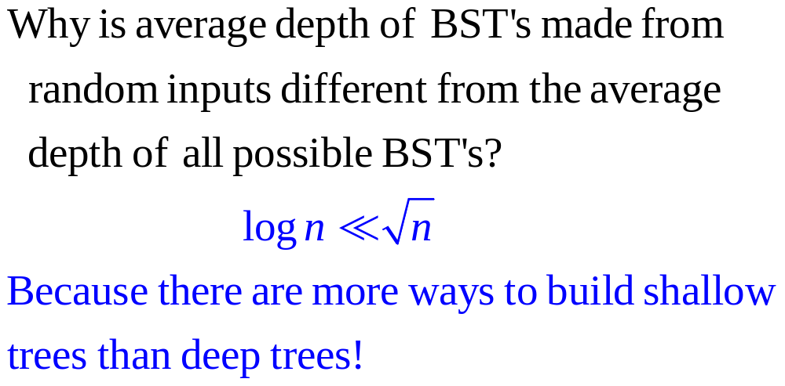

Slide 27
Random Input vs. Random Trees
Trees
Inputs
1,2,3
3,2,1
1,3,2
3,1,2
2,1,3
2,3,1
For three items, the shallowest tree is twice as likely as any other – effect grows as n increases. For n=4, probability of getting a shallow tree > 50%

Slide 28
Deletion
10
5
15
2
9
20
7
17
30
Why might deletion be harder than insertion?
Notes:
And now for something completely different.
Let’s say I want to delete a node. Why might it be harder than insertion?
Might happen in the middle of the tree instead of at leaf.
Then, I have to fix the BST.

Slide 29
FindMin/FindMax
10
5
15
2
9
20
Node min(Node root) {
if (root.left == NULL)
return root;
else
return min(root.left); }
7
17
30
How many children can the min of a node have?
Notes:
Every now and then everyone succumbs to the temptation to really overuse color.

Slide 30
Successor
Find the next larger node
in this node’s subtree.
  not next larger in entire tree
Node succ(Node root) {
if (root.right == NULL)
return NULL;
else
return min(root.right);
}
10
5
15
2
9
20
7
17
30
How many children can the successor of a node have?
Notes:
Here’s a little digression.
Maybe it’ll even have an application at some point.
Find the next larger node in 10’s subtree.
Can we define it in terms of min and max?
It’s the min of the right subtree!

Slide 31
Deletion - Leaf Case
Delete(17)
10
5
15
2
9
20
7
17
30
Notes:
Alright, we did it the easy way, but what about real deletions?
Leaves are easy; we just prune them.

Slide 32
Deletion - One Child Case
Delete(15)
10
5
15
2
9
20
7
30
Notes:
Single child nodes we remove and…
Do what?
We can just pull up their children.
Is the search tree property intact?
Yes.

Slide 33
Deletion - Two Child Case
Delete(5)
10
5
20
2
9
30
7
replace node with value guaranteed to be between the left and right subtrees: the successor
Could we have used the predecessor instead?
Notes:
Ah, now the hard case.
How do we delete a two child node?
We remove it and replace it with what?
It has all these left and right children that need to be greater and less than the new value (respectively).
Is there any value that is guaranteed to be between the two subtrees?
Two of them: the successor and predecessor!
So, let’s just replace the node’s value with it’s successor and then delete the succ.

Slide 34
Deletion - Two Child Case
Delete(5)
10
5
20
2
9
30
7
always easy to delete the successor – always has either 0 or 1 children!
Notes:
Ah, now the hard case.
How do we delete a two child node?
We remove it and replace it with what?
It has all these left and right children that need to be greater and less than the new value (respectively).
Is there any value that is guaranteed to be between the two subtrees?
Two of them: the successor and predecessor!
So, let’s just replace the node’s value with it’s successor and then delete the succ.

Slide 35
Deletion - Two Child Case
Delete(5)
10
7
20
2
9
30
7
Finally copy data value from deleted successor into original node
Notes:
Ah, now the hard case.
How do we delete a two child node?
We remove it and replace it with what?
It has all these left and right children that need to be greater and less than the new value (respectively).
Is there any value that is guaranteed to be between the two subtrees?
Two of them: the successor and predecessor!
So, let’s just replace the node’s value with it’s successor and then delete the succ.

Slide 36
Lazy Deletion
Instead of physically deleting nodes, just mark them as deleted
  simpler
  physical deletions done in batches
  some adds just flip deleted flag
  extra memory for deleted flag
  many lazy deletions slow finds
  some operations may have to be modified (e.g., min and max)
10
5
15
2
9
20
7
17
30
Notes:
Now, before we move on to all the pains of true deletion, let’s do it the easy way.
We’ll just pretend we delete deleted nodes.
This has some real advantages:
…

Slide 37
Dictionary Implementations
 | unsorted array | sorted array | linked list | BST
insert | find + O(1) | O(n) | find + O(1) | O(Depth)
find | O(n) | O(log n) | O(n) | O(Depth)
delete | find + O(1) | O(n) | find + O(1) | O(Depth)
BST’s looking good for shallow trees, i.e. the depth D is small (log n), otherwise as bad as a linked list!

Slide 38

CSE 326: Data Structures
Part 3: Trees, continued
Balancing Act
Henry Kautz
Autumn Quarter 2002
Notes:
Alright, today we’ll get a little Yin and Yang.
We saw B-Trees, but they were just too hard to use!
Let’s see something easier! (a bit)

Slide 39
Beauty is Only θ(log n) Deep
Binary Search Trees are fast if they’re shallow
  e.g.: complete
Problems occur when one branch is much longer than the other
  How to capture the notion of a “sort of” complete tree?
Notes:
What makes a good BST good?
Here’s two examples. Are these the only good BSTs?
No!
Anything without too many long branches is good, right?

Slide 40
Balance
t
5
6
balance = height(left subtree) - height(right subtree)
convention: height of a “null” subtree is -1
zero everywhere ⇒ perfectly balanced
small everywhere ⇒ balanced enough: θ(log n)
  Precisely: Maximum depth is 1.44 log n
Notes:
We’ll use the concept of Balance to keep things shallow.

Slide 41
AVL Tree
Dictionary Data Structure
8
Binary search tree properties
Balance of every node is -1 ≤ b ≤ 1
Tree re-balances itself after every insert or delete
5
11
2
6
10
12
4
7
9
13
14
15
What is the balance of each node in this tree?
Notes:
So, AVL trees will be Binary Search Trees with one extra feature:
They balance themselves!
The result is that all AVL trees at any point will have a logarithmic asymptotic bound on their depths

Slide 42
AVL Tree Data Structure
10
data
3
10
3
height
children
1
2
5
15
0
0
0
1
2
9
12
20
0
0
17
30
Notes:
Here’s a revision of that tree that’s balanced. (Same values, similar tree)
This one _is_ an AVL tree (and isn’t leftist).
I also have here how we might store the nodes in the AVL tree.
Notice that I’m going to keep track of height all the time. WHY?

Slide 43
Not An AVL Tree
10
data
4
10
4
height
children
1
3
5
15
0
0
0
2
2
9
12
20
1
0
17
30
0
18

Slide 44
Bad Case #1
Insert(small)
Insert(middle)
Insert(tall)
2
S
1
M
0
T
Notes:
But, let’s start over…
Insert [SMALL]
Now, [MIDDLE].
Now, [TALL].
Is this tree balanced?
NO!
Who do we need at the root?
[MIDDLE!]
Alright, let’s pull er up.

Slide 45
Single Rotation
2
S
1
M
1
M
0
0
S
T
0
T
Basic operation used in AVL trees:
A right child could legally have its parent as its left child.
Notes:
This is the basic operation we’ll use in AVL trees.
Since this is a right child, it could legally have the parent as its left child.
When we finish the rotation, we have a balanced tree!

Slide 46
General Case: Insert Unbalances
h + 1
h + 2
a
a
h
h - 1
h + 1
b
h - 1
b
X
X
h-1
h - 1
h
h - 1
Z
Y
Z
Y
h + 1
b
h
h
a
Z
h - 1
h - 1
Y
X
Notes:
Here’s the general form of this.
We insert into the red tree. That ups the three heights on the left.
Basically, you just need to pull up on the child.
Then, ensure that everything falls in place as legal subtrees of the nodes.
Notice, though, the height of this subtree is the same as it was before the insert into the red tree.
So?
So, we don’t have to worry about ancestors of the subtree becoming imbalanced; we can just stop here!

Slide 47
Properties of General Insert + Single Rotation
Restores balance to a lowest point in tree where imbalance occurs
After rotation, height of the subtree (in the example, h+1) is the same as it was before the insert that imbalanced it
Thus, no further rotations are needed anywhere in the tree!

Slide 48
Bad Case #2
Insert(small)
Insert(tall)
Insert(middle)
2
S
1
T
Why won’t a single rotation (bringing T up to the top) fix this?
0
M
Notes:
There’s another bad case, though.
What if we insert:
[SMALL]
[TALL]
[MIDDLE]
Now, is the tree imbalanced?
Will a single rotation fix it?
(Try it by bringing up tall; doesn’t work!)

Slide 49
Double Rotation
2
2
S
S
1
M
1
1
T
M
0
0
0
S
T
0
M
T
Notes:
Let’s try two single rotations, starting a bit lower down.
First, we rotate up middle.
Then, we rotate up middle again!
Is the new tree balanced?

Slide 50
General Double Rotation
h + 3
a
h + 2
h + 2
c
h
b
Z
h+1
h+1
h
b
a
W
h+1
h
c
h
Y
h
W
X
Z
h
X
Y
Initially: insert into X unbalances tree (root height goes to h+3)
“Zig zag” to pull up c – restores root height to h+2, left subtree height to h
Notes:
Here’s the general form of this.
Notice that the difference here is that we zigged one way than zagged the other to find the problem.
We don’t really know or care which of X or Y was inserted into, but one of them was.
To fix it, we pull c all the way up.
Then, put a, b, and the subtrees beneath it in the reasonable manner.
The height is still the same at the end!

Slide 51
Another Double Rotation Case
h + 3
a
h + 2
h + 2
c
h
b
Z
h+1
h+1
b
a
h
W
h+1
h
c
h
h
X
Y
W
Z
Y
X
h
Initially: insert into Y unbalances tree (root height goes to h+2)
“Zig zag” to pull up c – restores root height to h+1, left subtree height to h
Notes:
Here’s the general form of this.
Notice that the difference here is that we zigged one way than zagged the other to find the problem.
We don’t really know or care which of X or Y was inserted into, but one of them was.
To fix it, we pull c all the way up.
Then, put a, b, and the subtrees beneath it in the reasonable manner.
The height is still the same at the end!

Slide 52
Insert Algorithm
Find spot for value
Hang new node
Search back up looking for imbalance
If there is an imbalance:
  “outside”: Perform single rotation and exit
  “inside”: Perform double rotation and exit
Notes:
OK, thank you BST Three!
And those two cases (along with their mirror images) are the only four that can happen!
So, here’s our insert algorithm.
We just hang the node.
Search for a spot where there’s imbalance.
If there is, fix it (according to the shape of the imbalance).
And then we’re done; there can only be one problem!

Slide 53
AVL Insert Algorithm
Node insert(Comparable x, Node root){
// returns root of revised tree
if ( root == NULL )
return new Node(x);
if (x <= root.key){
root.left = insert( x, root.left );
if (root unbalanced) { rotate... } }
else { // x > root.key
root.right = insert( x, root.right );
if (root unbalanced) { rotate... } }
root.height = max(root.left.height,
root.right.height)+1;
return root;
}

Slide 54
Deletion (Really Easy Case)
3
Delete(17)
10
2
2
5
15
1
0
0
1
2
9
12
20
0
0
0
3
17
30
Notes:
OK, if we have a bit of extra time, do this.
Let’s try deleting.
15 is easy! It has two children, so we do BST deletion.
17 replaces 15.
15 goes away.
Did we disturb the tree?
NO!

Slide 55
Deletion (Pretty Easy Case)
3
Delete(15)
10
2
2
5
15
1
0
0
1
2
9
12
20
0
0
0
3
17
30
Notes:
OK, if we have a bit of extra time, do this.
Let’s try deleting.
15 is easy! It has two children, so we do BST deletion.
17 replaces 15.
15 goes away.
Did we disturb the tree?
NO!

Slide 56
Deletion (Pretty Easy Case cont.)
3
Delete(15)
10
2
2
5
17
1
0
0
1
2
9
12
20
0
0
3
30
Notes:
OK, if we have a bit of extra time, do this.
Let’s try deleting.
15 is easy! It has two children, so we do BST deletion.
17 replaces 15.
15 goes away.
Did we disturb the tree?
NO!

Slide 57
Deletion (Hard Case #1)
3
Delete(12)
10
2
2
5
17
1
0
0
1
2
9
12
20
0
0
3
30
Notes:
Now, let’s delete 12.
12 goes away.
Now, there’s trouble.
We’ve put an imbalance in.
So, we check up from the point of deletion and fix the imbalance at 17.

Slide 58
Single Rotation on Deletion
3
3
10
10
2
2
2
1
5
17
5
20
1
0
1
1
0
0
0
2
9
20
2
9
17
30
0
0
0
3
30
3
What is different about
deletion than insertion?
Notes:
But what happened on the fix?
Something very disturbing.
What?
The subtree’s height changed!!
So, the deletion can propagate.

Slide 59
Deletion (Hard Case)
4
Delete(9)
10
2
3
5
17
1
0
2
2
12
2
9
12
20
20
0
0
1
0
1
3
30
11
15
30
15
18
0
0
0
0
0
33
13
33
13
Notes:
Now, let’s delete 12.
12 goes away.
Now, there’s trouble.
We’ve put an imbalance in.
So, we check up from the point of deletion and fix the imbalance at 17.

Slide 60
Double Rotation on Deletion
Not finished!
4
4
10
10
2
3
1
3
5
17
3
17
1
2
2
0
0
2
2
2
12
12
2
20
2
5
20
0
0
1
0
1
0
1
0
1
3
11
15
18
30
11
15
18
30
0
0
0
0
0
13
33
13
33

Slide 61
Deletion with Propagation
4
10
1
3
What different about this case?
3
17
0
0
2
2
2
5
12
20
0
1
0
1
11
15
18
30
We get to choose whether
to single or double rotate!
0
0
13
33

Slide 62
Propagated Single Rotation
4
4
10
17
1
3
3
2
3
17
10
20
0
0
2
2
1
2
0
1
2
5
12
20
3
12
18
30
0
1
0
1
0
0
0
1
0
11
15
18
30
2
5
11
15
33
0
0
0
13
33
13

Slide 63
Propagated Double Rotation
4
4
10
12
1
3
2
3
3
17
10
17
0
0
2
2
1
0
1
2
2
5
12
20
3
11
15
20
0
1
0
1
0
0
0
0
1
11
15
18
30
2
5
13
18
30
0
0
0
13
33
33

Slide 64
AVL Deletion Algorithm
Recursive
If at node, delete it
Otherwise recurse to find it in
3. Correct heights
a. If imbalance #1,
single rotate
b. If imbalance #2 (or don’t care),
double rotate
Iterative
1. Search downward for
node, stacking
parent nodes
2. Delete node
3. Unwind stack,
correcting heights
a. If imbalance #1,
single rotate
b. If imbalance #2 (or don’t care)
double rotate
Notes:
OK, here’s the algorithm again.
Notice that there’s very little difference between the recursive and iterative.
Why do I keep a stack for the iterative version?
To go bottom to top.
Can’t I go top down?
Now, what’s left?
Single and double rotate!

Slide 65
AVL
Automatically Virtually Leveled
Architecture for inVisible Leveling
Articulating Various Lines
Amortizing? Very Lousy!
Amazingly Vexing Letters

Slide 66
AVL
Automatically Virtually Leveled
Architecture for inVisible Leveling
Articulating Various Lines
Amortizing? Very Lousy!
Amazingly Vexing Letters
Adelson-Velskii Landis

Slide 67
Pros and Cons of AVL Trees
Pro:
All operations guaranteed O(log N)
The height balancing adds no more than a constant factor to the speed of insertion
Con:
Space consumed by height field in each node
Slower than ordinary BST on random data
Can we guarantee O(log N) performance with less overhead?

Slide 68
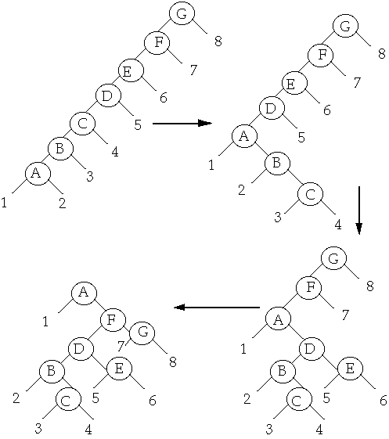
Splay
Trees
CSE 326: Data Structures
Part 3: Trees, continued
Notes:
Alright, today we’ll get a little Yin and Yang.
We saw B-Trees, but they were just too hard to use!
Let’s see something easier! (a bit)

Slide 69
Today: Splay Trees
Fast both in worst-case amortized analysis and in practice
    Are used in the kernel of NT for keep track of process information!
    Invented by Sleator and Tarjan (1985)
Details:
    Weiss 4.5 (basic splay trees)
    11.5 (amortized analysis)
    12.1 (better “top down” implementation)
Notes:
We’ll start by introducing AVL trees.
Then, I’d like to spend some time talking about double-tailed distributions and means.
Next, we’ll gind out what AVL stands for.
Finally, you’ll receive a special bonus if we get to it!
(Unfortunately, the bonus is AVL tree deletion)

Slide 70
Basic Idea
“Blind” rebalancing – no height info kept!
Worst-case time per operation is O(n)
Worst-case amortized time is O(log n)
Insert/find always rotates node to the root!
Good locality:
  Most commonly accessed keys move high in tree – become easier and easier to find

Slide 71
Idea
move n to root by series of zig-zag and zig-zig rotations, followed by a final single rotation (zig) if necessary
10
You’re forced to make
a really deep access:
17
Since you’re down there anyway,
fix up a lot of deep nodes!
5
2
9
3

Slide 72
Zig-Zag*
Helped
Unchanged
Hurt
g
n
up 2
X
p
g
p
down 1
down 1
up 1
n
W
X
Y
Z
W
Y
Z
*This is just a double rotation
Notes:
This is just a double rotation.

Slide 73
Zig-Zig
g
n
W
p
p
Z
X
n
g
Y
Y
Z
W
X
Notes:
Can anyone tell me how to implement this with two rotations?
There are two possibilities:
Start with rotate n
or rotate p?
Rotate p!
Rotate n makes p n’s left child and then we’re hosed.
Then, rotate n.
This helps all the nodes in blue and hurts the ones in red. So, in some sense, it helps and hurts the same number of nodes on one rotation.
Question: what if we keep rotating? What happens to this whole subtree?
It gets helped!

Slide 74
Why Splaying Helps
Node n and its children are always helped (raised)
Except for last step, nodes that are hurt by a zig-zag or zig-zig are later helped by a rotation higher up the tree!
Result:
  shallow nodes may increase depth by one or two
  helped nodes decrease depth by a large amount
If a node n on the access path is at depth d before the splay, it’s at about depth d/2 after the splay
  Exceptions are the root, the child of the root, and the node splayed
Notes:
Alright, remember what we did on Monday.
We learned how to splay a node to the root of a search tree.
We decided it would help because we’d go a lot of fixing up if we had an expensive access.
That means we have to fix up the tree on every expensive access.

Slide 75
Splaying Example
1
1
2
2
zig-zig
3
3
Find(6)
4
6
5
5
6
4

Slide 76
Still Splaying 6
1
1
2
6
zig-zig
3
3
6
2
5
5
4
4

Slide 77
Almost There, Stay on Target
1
6
6
1
zig
3
3
2
5
2
5
4
4

Slide 78
Splay Again
6
6
1
1
zig-zag
3
4
Find(4)
2
5
3
5
4
2

Slide 79
Example Splayed Out
6
4
1
1
6
zig-zag
4
3
5
3
5
2
2

Slide 80
Locality
“Locality” – if an item is accessed, it is likely to be accessed again soon
  Why?
Assume m ≥ n access in a tree of size n
  Total worst case time is O(m log n)
  O(log n) per access amortized time
Suppose only k distinct items are accessed in the m accesses.
  Time is O(n log n + m log k )
  Compare with O( m log n ) for AVL tree
those k items are all at the top of the tree
getting those k items near root

Slide 81
Splay Operations: Insert
To insert, could do an ordinary BST insert
  but would not fix up tree
  A BST insert followed by a find (splay)?
Better idea: do the splay before the insert!
How?
Notes:
What about insert?
Ideas?
Can we just do BST insert?
NO. Because then we could do an expensive operation without fixing up the tree.

Slide 82
Split
Split(T, x) creates two BST’s L and R:
  All elements of T are in either L or R
  All elements in L are ≤ x
  All elements in R are ≥ x
  L and R share no elements
Then how do we do the insert?
Notes:
What about insert?
Ideas?
Can we just do BST insert?
NO. Because then we could do an expensive operation without fixing up the tree.

Slide 83
Split
Split(T, x) creates two BST’s L and R:
  All elements of T are in either L or R
  All elements in L are ≤ x
  All elements in R are > x
  L and R share no elements
Then how do we do the insert?
  Insert as root, with children L and R
Notes:
What about insert?
Ideas?
Can we just do BST insert?
NO. Because then we could do an expensive operation without fixing up the tree.

Slide 84
Splitting in Splay Trees
How can we split?
  We have the splay operation
  We can find x or the parent of where x would be if we were to insert it as an ordinary BST
  We can splay x or the parent to the root
  Then break one of the links from the root to a child
Notes:
How can we implement this?
We can splay.
We can find x or where x ought to be.
We can splay that spot to the root.
Now, what do we have?
The left subtree is all <= x
The right is all >= x

Slide 85
Split
could be x, or what would have been the parent of x
split(x)
T
splay
L
R
if root is > x
if root is ≤ x
OR
L
R
L
R
  ≤ x
> x
< x
  > x
Notes:
So, a split just splays x’s spot to the root then hacks off one subtree.
This code is _very_ pseudo. You should only use it as a general guideline.

Slide 86
Back to Insert
x
split(x)
L
R
L
R
≤ x
> x
Insert(x):
Split on x
Join subtrees using x as root
Notes:
Now, If we can split on x and produce one subtree smaller and one larger than x, insert is easy!
Just split on x.
Then, hang the left (smaller) subtree on the left of x.
Hang the right (larger) subtree on the right of x.
Pretty simple, huh?
Are we fixing up deep paths?

Slide 87
Insert Example
Insert(5)
6
4
4
6
1
9
split(5)
1
6
1
9
4
7
2
9
2
7
2
7
5
4
6
1
9
2
7
Notes:
Let’s do some examples.

Slide 88
Splay Operations: Delete
x
find(x)
delete x
L
R
L
R
< x
> x
Now what?
Notes:
OK, we’ll do something similar for delete.
We know x is in the tree.
Find it and bring it to the root.
Remove it.
Now, we have to split subtrees.
How do we put them back together?

Slide 89
Join
Join(L, R): given two trees such that L < R, merge them
Splay on the maximum element in L then attach R
splay
L
L
R
R
Notes:
The join operation puts two subtrees together as long as one has smaller keys to begin with.
First, splay the max element of L to the root.
Now, that’s gauranteed to have no right child, right?
Just snap R onto that NULL right side of the max.

Slide 90
Delete Completed
x
T
find(x)
delete x
L
R
L
R
< x
> x
Join(L,R)
T - x
Notes:
So, we just join the two subtrees for delete.

Slide 91
Delete Example
Delete(4)
6
4
6
1
9
find(4)
1
6
1
9
4
7
2
9
2
7
Find max
2
7
2
2
1
6
1
6
9
9
7
7

Slide 92
Splay Trees, Summary
Splay trees are arguably the most practical kind of self-balancing trees
If number of finds is much larger than n, then locality is crucial!
  Example: word-counting
Also supports efficient Split and Join operations – useful for other tasks
  E.g., range queries

